Slide 1
FOOTWEAR SHOP MANAGEMENT SYSTEM

Slide 2
ABSTRACT
Here we shared Footwear Shop Management System Project Report which is developed using eclipse. The Footwear Shop is a very popular and widely used in many big shoe stores and is used to cater the need of the sales system there. This is software application and is used maintain control most of the activities happening in big stores. This maintains and controls the stock details and does billing and generates various reports.
The Footwear Shop Management System will allow more than one shop owner, to sell various products less than one roof. “Details of products in the stock with product code, brand name, size, quantity” Footwear Shop Management System is inventory software that designed specially to meet the requirements of small and medium sized enterprises, such as shoe stores whole sale or retail. It is easy to create invoice, do inventory control like invoice management, stock balance management, goods item management, goods category management, staff sales records management and staff permission management, backup and restore stock by Shoe Inventory’s user friendly and graphical interface and functionalities. And Shoe Inventory supports full customizable Company info, tax code and value, invoice number etc.

Slide 3
HARDWARE SPECFICATION
Processor : P 4 700 GHz.
RAM : 4 GB RAM
Hard Disk Drive : 180 GB

Slide 4
SOFTWARE SPECIFICATION
Operating System : Windows 7/8/10
Front End : JAVA
Back End : SQL

Slide 5
EXISTING SYSTEM
Here the shop has been handled by manually, so it’s very hard to managing the footwear shop. Each and every purchase and sales can be handling into the paper and managing it. Here there’s an no records have been provided to the owner or manager. These kinds of issues may be happened in the existing system
Disadvantages
No records will be provided by the system
Man power increases
Very hard to find the stock details

Slide 6
PROPOSED SYSTEM
Here in this system provide lot of features, like purchase, sales and stock details. Once the admin registered these records can be followed by the system. Here we can provide the details in less minute time.
Advantages
Easy to managing the billing details
Easy to get report for stock details

Slide 7
Modules
Customer Registration
This module will be collecting the all the information about the customer, when customer visit or purchase any product admin has collect the customer details and register here,
Product Registration
This module admin registers the product details, what are the products are available into the footwear shop, once it’s added it will be stored into the product table.
Purchase
When owner purchasing the product for a shop, it should manage by this module. each and every purchase detail are should be managing here, then only we can maintain the stock details.

Slide 8
Sales
This module is act as an when customer purchasing the shoes or anything admin collect the purchase details and sales it. Then it will show the total cost rupees in a sales screen.
Stock
This module helps to shown the what are the stocks are available in the shop, we can easily identify the overall stock in the single screen. Also, can able to find the what are the stocks will be close find then can purchase the order.
Billing
This module has to shown the billing details for the footwear shop. We can see the billing detail as a date wise and customer wise. Which can provide the report to the shop

Slide 9

Data Flow Diagram
Level 0:

Slide 10
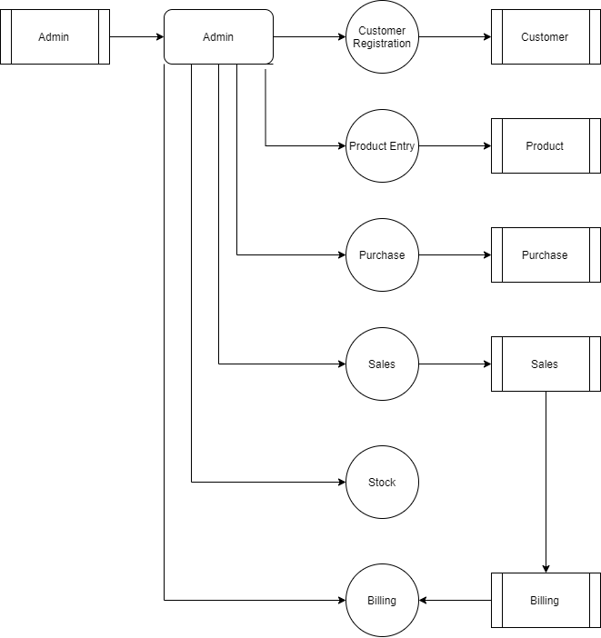
Level 1:

Slide 11
Thank You

